Slide 1


Comparație între hepatitele E și A într-un spital universitar din nord-vestul României
Hepatita acută E – o boală ușoară?
Conf. Dr. Amanda Rădulescu ● Alexandru Istrate

Slide 2
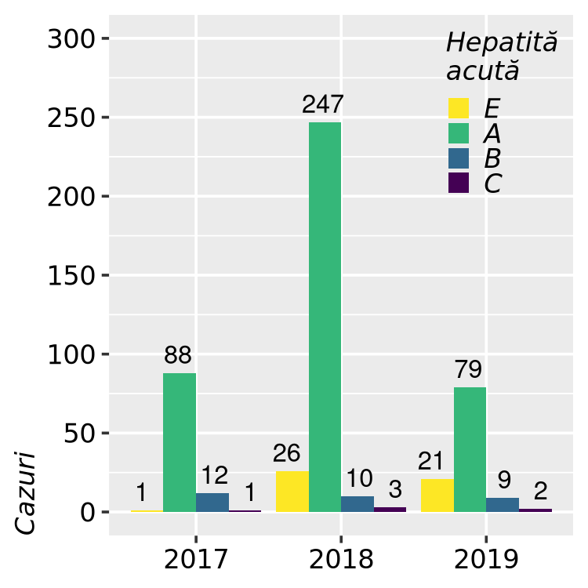
Background
HEV incidence in Europe / Romania
Notes:
The incidence of locally acquired hepatitis E increased in recent years across Europe. There are only a few data on hepatitis E in Romania.

Slide 3
Obiective
Descrierea și coparația dintre hepatitele acute E și A la pacienții adulți.

Slide 4
Material și metode
Studiu retropectiv, caz-caz
Am inclus toți pacienții adulți cu:
hepatită acută E (ICM10: B17.2) și
hepatită acută A (ICM10: B15.*) internați în
Spitalul Clinic de Boli Infecțioase, Cluj-Napoca
în perioada Ianuarie 2017 - August 2019.
Definiție de caz pentru hepatita acută:
criterii clinice și de laborator
tesatare serologică
criterii epidemiologice

Slide 5
Material și metode: cazuri severe
Hepatita E*
Hepatita A*
INR >1.5
encefalopatie hepatică gr. 2-4
comorbidități (acute-on-chronic liver disease, imunosupresie confirmată)
manifestatări neurologice
INR >1.5
encefalopatie hepatică gr. 2-4
Tratament suportiv plus
ribavirină (600-800 mg/zi)
Tratament suportiv plus
plasmă
* EASL 2018, hospital protocol
* EASL 2016, hospital protocol

Slide 6
Metode statisitice
Comparație între grupurile cu hepatită E și A folosind:
metode univariate (teste t pentru variabile numerice cu distribuție normală conform testului Shapiro-Wilk, test Mann-Whitney pentru variabile numerice cu distribuție non-normală, test Fisher pentru variabile binare)
multivariate (regresie logistică):
model 1: ajustând pentru vârstă și sex
model 2: ajustând pentru comorbidități.

Slide 7
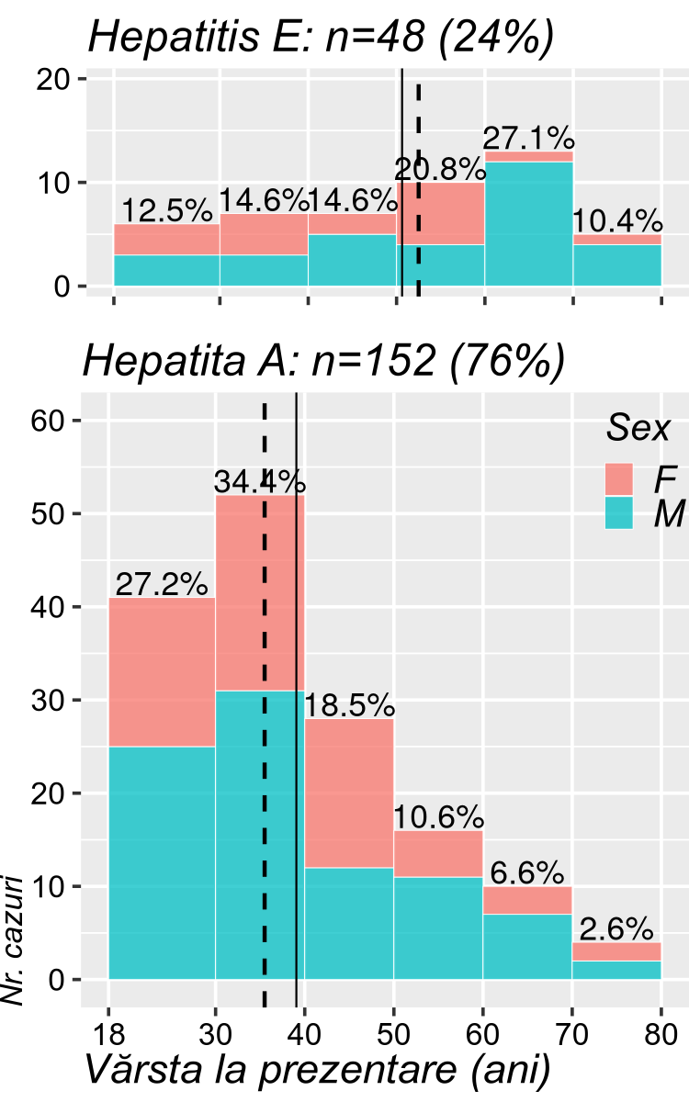
Rezultate: demograafie
Hepatita: |  | E: n (%) | A: n (%) | p
 |  | 48 (24.0%) | 152 (76.0%)
Sex | M | 31 (64.6%) | 88 (57.9%) | ns.
 | F | 17 (35.4%) | 64 (42.1%)
Vârsta la prezentare (ani) | Media ±DS | 50.62 ±15.6 | 39.06 ±15.0 | p<0.001
 | 50+ | 28 (58.3%) | 31 (20.4%)
 | [40, 50) | 7 (14.6%) | 28 (18.4%)
 | [30, 40) | 7 (14.6%) | 52 (34.2%)
 | [18, 30) | 6 (12.5%) | 41 (27.0%)
Durata spitalizării (zile) | Mediana (IQR) | 9 (7-14) | 11 (8-14) | ns.
Notes:
The average age in hepatitis E (n=48) patients was 50.6 versus 39.1 years in hepatitis A (n=152) and two thirds of the patients in both groups were men.

Slide 8
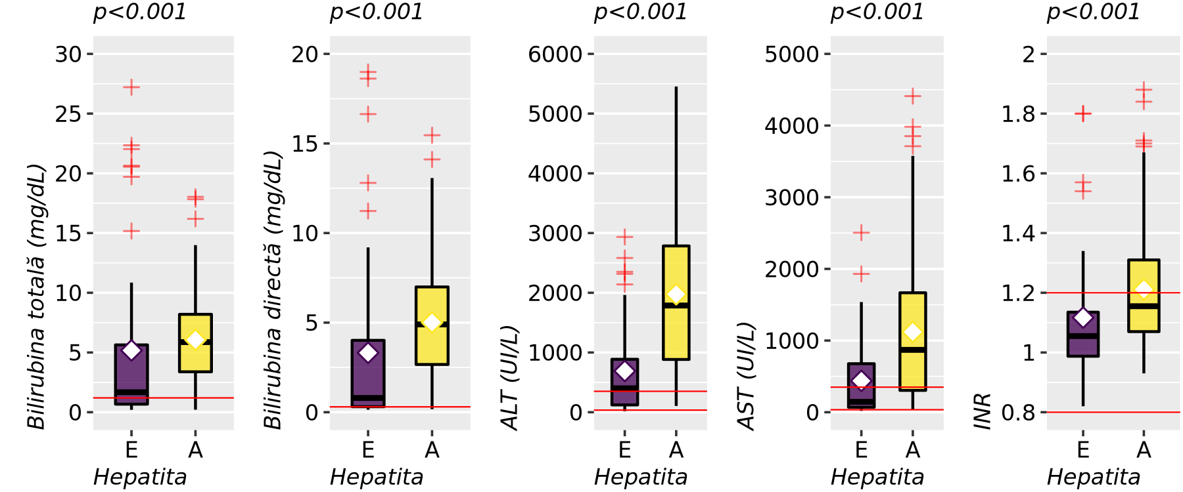
Rezultate: funcția hepatică
Notes:
Compared to hepatitis A, patients with hepatitis E presented with significantly less modified bilirubin, transaminase and and INR levels.

Slide 9
Rezultate: funcția hepatică
Hepatita: Mediana (IQR) | E: n (%) | A: n (%) | Statistică univariată | OR ajustat pt. vârstă & sex [IC 95%], p
 | 48 (24.0%) | 152 (76.0%)
AST (UI/L, log10) | 145.5 (69-676.75) | 870 (304.5-1666.75) | MW: p<0.001 | 0.112 [0.05, 0.23], p<0.001
> 350 | 17 (35.4%) | 99 (65.1%) | OR=0.29 [0.15, 0.58], p<0.001 | 0.249 [0.12, 0.51], p<0.001
ALT (UI/L, log10) | 401 (122.75-886.25) | 1817.5 (919.25-2801.75) | MW: p<0.001 | 0.045 [0.02, 0.11], p<0.001
> 350 | 26 (54.2%) | 132 (86.8%) | OR=0.18 [0.09, 0.37], p<0.001 | 0.12 [0.05, 0.27], p<0.001
Notes:
At admission, Transaminases showed only moderate increases in hepatits E patients with only one third for AST and half of the patients, for ALT, showing values 10 times larger that our laboratory's reference values. Both enzymes were significantly more increased in hepatitis A, regardless of age or gender.
both variables were transformed to base 10 logarithms before multivariate analysis, soodds-ratios reflect tenfold increases/decreases in the original laboratory values

Slide 10
Rezultate: funcția hepatică
Hepatita: Mediana (IQR) | E: n (%) | A: n (%) | Statistică univariată | OR ajustat pt. vârstă & sex [IC 95%], p
 | 48 (24.0%) | 152 (76.0%)
Bilirubina directă (mg/dL, log10) | 1.24 (0.34-5.02) | 4.9 (2.66-6.99) | MW: p<0.001 | 0.194 [0.09, 0.38], p<0.001
Bilirubina totală (mg/dL, log10) | 1.73 0.68-5.76) | 5.87 (3.38-8.2) | MW: p<0.001 | 0.182 [0.08, 0.39], p<0.001
Fosfataza alcalină (IU/L, log10) | 154.5 (119.25-192.75) | 205 (159.25-260.5) | MW: p<0.001 | 0.046 [0.01, 0.34], p=0.003
γ-GT (IU/L, log10) | 229 (123.5-327) | 246 (154.75-355.5) | MW: ns. | 0.343 [0.12, 0.99], p<0.048
Notes:
Similarly, bilirubin values at admission were much lower than in hepatitis A patients. Alcaline phosphatase and gamma-GT values both had smaller increases in hepatitis E. Controlling for age and gender, all appear significantly less modified.

Slide 11
Rezultate: hemostaza
Hepatita: Mediana (IQR) | E: n (%) | A: n (%) | Statistică univariată | OR ajustat pt. vârstă & sex [IC 95%], p
 | 48 (24.0%) | 152 (76.0%)
Index de protrombină (%) | 88.25 (75.2-100.38) | 72.7 (59.9-86.85) | T-test: p<0.001 | 1.039 [1.02, 1.06], p<0.001
< 70 | 9 (18.8%) | 60 (42.0%) | OR=0.32 [0.14, 0.71], p=0.005 | 0.268 [0.11, 0.61], p=0.002
INR | 1.06 (0.99-1.13) | 1.16 (1.07-1.31) | MW: p<0.001 | 0.036 [0.0, 0.26], p=0.002
> 1.5 | 4 (8.3%) | 16 (11.2%) | ns. | ns.
Notes:
Coagulation paramenters were also worse in hepatitis A patients, however coagulopathy with INR above 1.5, which required plasma products, was found in aproximatively 10% of the patients of both groups.

Slide 12
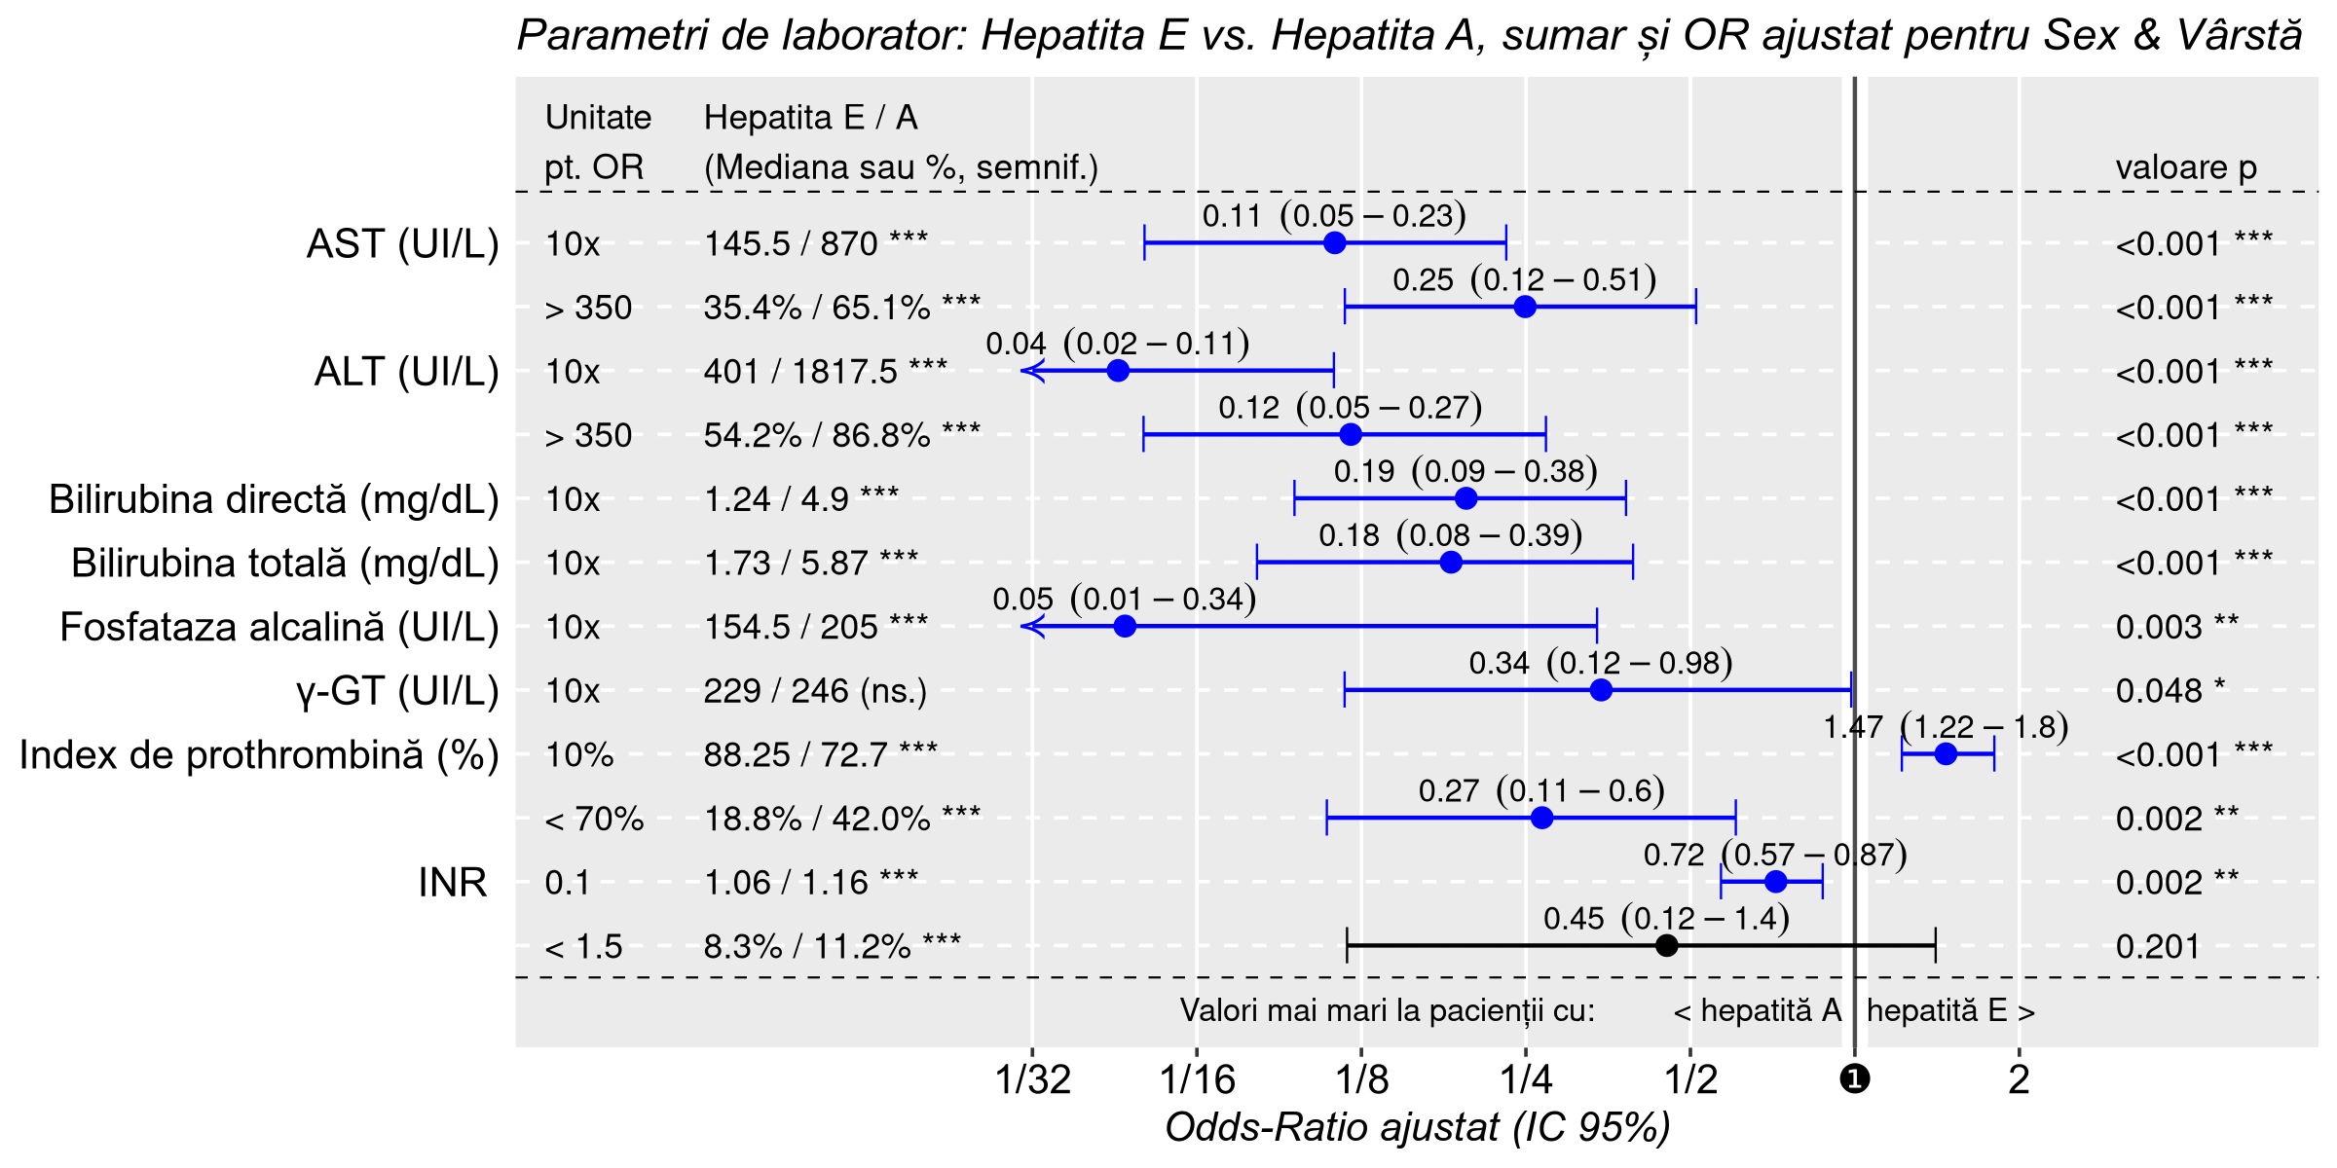
–●– Univariate, unadjusted
–●– Model 1: Adjusted for Age & Sex
Notes:
At admission, Transaminases showed only moderate increases in hepatits E patients with only one third for AST and half of the patients, for ALT, showing values 10 times larger that our laboratory's reference values. Both enzymes were significantly more increased in hepatitis A, regardless of age or gender.
both variables were transformed to base 10 logarithms before multivariate analysis, soodds-ratios reflect tenfold increases/decreases in the original laboratory values
Similarly, bilirubin values at admission were much lower than in hepatitis A patients. Alcaline phosphatase and gamma-GT values both had smaller increases in hepatitis E. Controlling for age and gender, all appear significantly less modified.
Coagulation paramenters were also worse in hepatitis A patients, however coagulopathy with INR above 1.5, which required plasma products, was found in aproximatively 10% of the patients of both groups.
For these, adjusted odds ratios are relative to every 10% and 0.1 points variations in prothrombin index and INR, respectively

Slide 13
Rezultate: comorbidități
Hepatita: n (%) | E: n (%) | A: n (%) | Statistică univariată OR [95% CI], p | OR ajustat pt. vârstă & sex [IC 95%], p
 | 48 (24.0%) | 152 (76.0%)
Boli cronice hepatice | 13 (27.1%) | 6 (3.9%) | 9.04 [3.21, 25.45], p<0.001 | 7.19 [2.53, 22.73], p<0.001
dintre care:
Ciroză hepatică | 6 (12.5%) | 1 (0.7%) | 21.57 [2.53, 184.16], p<0.001 | 12.5 [1.86, 250], p=0.026
Hepatită cronică B | 6 (12.5%) | 4 (2.6%) | 5.29 [1.43, 19.60], p=0.014 | 6.71 [1.7, 29.41], p=0.007
OR ajustat (pt. comorbidități, incl. tabele următoare) = 6.21 [2.0, 20.5], p=0.002
Notes:
We found a higher prevalence of comorbidities in hepatitis E patients, regardless of age & gender. 27% of hepatitis E patients and only 4% of hepatitis A patients had chronic liver diasase, relation that remains significant after controling for demographics or other comorbidities.
Of them, liver cirrhosis is especially prevalent in hepatitis E.

Slide 14
Rezultate: comorbidități
Hepatita: n (%) | E: n (%) | A: n (%) | Statistică univariată | AOR ajustat pt. vârstă & sex [IC 95%], p | OR ajustat* pt. comorbidități [IC 95%], p
 | 48 (24.0%) | 152 (76.0%)
Boli neurologice | 6 (12.5%) | 2 (1.3%) | 10.71 [2.09, 55.04], p=0.003 | 9.52 [1.89, 71.43], p=0.011 | 4.76 [0.8, 38.3], p=0.098
Boli cronice renale | 5 (10.4%) | 2 (1.3%) | 8.72 [1.63, 46.54], p=0.009 | 5.18 [0.99, 38.46], p=0.065 | 6.175 [0.99, 50.0], p=0.056
Dizbet zaharat | 10 (20.8%) | 9 (5.9%) | 4.18 [1.59, 11.02], p=0.004 | 2.04 [0.69, 5.99], p=0.190 | 3.39 [1.1, 10.1], p=0.029
* incl. tablele următor și anterior
Notes:
We found other chronic comorbidities, more frequently in hepatitis E patients, all with rather impressive odds ratios. Adjusted for age and gender, only preexisting neurologic conditions remainined significatly associated more with hepatitis E with confidence intervals that bearly cross the neutrality line.

Slide 15
Rezultate: tratament adițional
Hepatita: n (%) | E: n (%) | A: n (%) | Statistică univariată OR [IC 95%], p | OR ajustat pt. vârstă & sex [IC 95%], p
 | 48 (24.0%) | 152 (76.0%)
Tratament adițional (in forme severe) | ribavirn: | plasma: | 6.78 [2.15, 21.40], p<0.001 | 4.93 [1.49, 17.86], p=0.010
 |  | 5 (3.3%)
 | 9 (18.8%)
OR ajustat (pt. comorbidități, incl. tabele anterioare) = 4.47 [1.2, 17.25], p=0.025

Slide 16
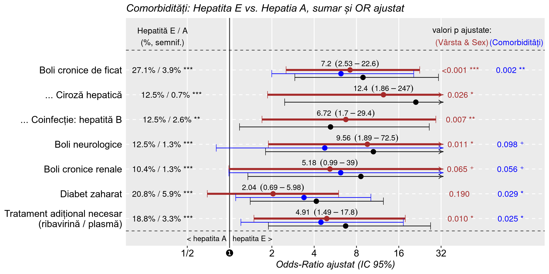
–●– Univariat, neajustat
–●– Model 1: Ajustat pt. Vârstă & Sex
–●– Model 2: Ajustat pt. Comorbidități
Notes:
We found a higher prevalence of comorbidities in hepatitis E patients, regardless of age & gender. 27% of hepatitis E patients and only 4% of hepatitis A patients had chronic liver diasase, relation that remains significant after controling for demographics or other comorbidities.
Of them, liver cirrhosis is especially prevalent in hepatitis E.
We found other chronic comorbidities, more frequently in hepatitis E patients, all with rather impressive odds ratios. Adjusted for age and gender, only preexisting neurologic conditions remainined significatly associated more with hepatitis E with confidence intervals that bearly cross the neutrality line.
Additional treatment was needed in 5 hepatitis A patients (where we administeted plasma pruducs) compared to 9 hepatitis E patients, where ribavirin was used.

Slide 17
Rezultate: pacienți care au primit ribavirină
Age, Sex | Direct bilirubin (mg/dL) | AST, ALT (IU/L) | INR | Ribavirin treatment (days) | Evolution
51♀ | 28.51 → 21.51 | 36 → 59, 15 → 24 | 1.17 → 1.02 | 10 / presumably continued | Breast cancer, liver, lung and bone metastases | transferred
21♂ | 0.25 → 0.19 | 19 → 20, 75 → 35 | 0.92 → 0.99 | 12 / 21 | Sagittal sinus thrombosis, bilateral facial palsy, one episode of seizures | transferred
36♂ | 25.02 → 19.17 | 191 → 149, 322 → 214 | 1.27 → 1.41 | 21 / presumably continued | Chronic hepatitis B with advanced fibrosis, MELD=23 (19.6% at 3 months) | transferred
38♂ | 1.67 → 1.98 | 1010 → 147, 1750 → 607 | 1.12 → 1.02 | 12 / up to 3 months | Hodgkin lymphoma with chemotherapy, bone marrow transplantation
63♂ | 16.64 → 3.9 | 270 → 53, 865 → 80 | 1.34 → 1.36 | 7 / 7 | Coagulation deficiency factors VIII & IX, autoimmune hepatitis
64♂ | 0.27 → 0.32 | 321 → 74, 1014 → 332 | 0.99 → 0.96 | 14 / 21 | Retroperitoneal liposarcoma
69♂ | 1.31 → 0.81 | 570 → 85, 436 → 141 | 1.12 → 1.01 | 2 / 15 | Newly diagnosed colon cancer, diabetes mellitus
74♂ | 0.67 → 1.16 | 460 → 37, 1013 → 219 | 1.06 → 0.96 | 21 / 21 | Ethanolic liver cirrhosis, Alzheimer and vascular and dementia, diabetes mellitus, MELD=7 (1.9% at 3 months)
75♂ | 24.1 → 7.11 | 645 → 44, 374 → 23 | 1.57 → 1.38 | 19 / 21 (thrombocytopenia) | Newly diagnosed ethanolic liver cirrhosis and hepatocarcinoma, MELD=24 (19.6% at 3 months) | transferred
Notes:
All hepatitis E patients who received ribavirin had favorable evolution and were either discharged at home or to another department for specialized treatment for their comorbidities.
A short course of ribavirin treatment, was considered for these patients and we observed good results. There was a tendency for normalization of laboratory parameters.
Ribavirin treatment was stopped after 19 days in this patient due to severe thrombocytopenia. Two patients were transferred to other clinics where their treatment was presumably continued.
One severely immunosuppressed patient was recommended 3 months but showed good results within the first 12 days.

Slide 18
Rezultate: decese
Vârsta, Sex | Bilirubina directă (mg/dL) | AST, ALT (UI/L) | INR | Comorbidități (cazue probabile ale decesului) | scor MELD (risc de deces la 3 luni)
59♂ | 18.99 → 28.3 | 618 → 73, 262 → 16.6 | 1.8 → 4.15 | Șoc hemoragic din varice esofagiene, ciroză hepatică etanolică (Child-Pugh C) | 35 (52.6%)
61♂ | 12.8 → 23.71 | 1537 → 253, 526 → 39.9 | 1.8 → 1.81 | Șoc hemoragic din varice esofagiene, ciroză hepatică etanolică (Child-Pugh C) | 27 (19.6%)
65♂ | 4.92 → 14.51 | 157 → 23, 50 → 56.4 | 1.54 → 1.37 | Insuficiență multiplă de organ, hepatită cronică B și ciroză hepatică etanolică (Child-Pugh B), endocardită, embolism cerebral | 31 (52.6%)
Notes:
The three deceased patients all had hepatitis E infection on top of end-stage alcoholic liver disease and none of them received ribavirin because of severe thrombocytopenia.
They represented 6.25% of all hepatitis E patients and 23.1% of hepatitis E patients with preexisting liver disease.
Two of them died because of bleeding from esophageal varices. The third patient, with chronic hepatitis B infection and endocarditis died because of cerebral hemorrhage, septic cerebral embolism and multiple system organ failure.

Slide 19
Concluzii
Hepatita E:
valori de laborator mai puțin modificate decât pentru hepatita A
mai frecventă la pacienții vârstnici, cu comorbidități
număr mai mare de cazuri severe și /sau fatale
Ribavirina ar putea fi benefică la paceinții cu
acute-on-chronic liver disease și/sau imunosupresie
Sunt necesare studii viitoare pentru a demostra efectul ribavirinei la acești pacienți.

Slide 20
Mulțumim pentru atenție!

